Slide 1
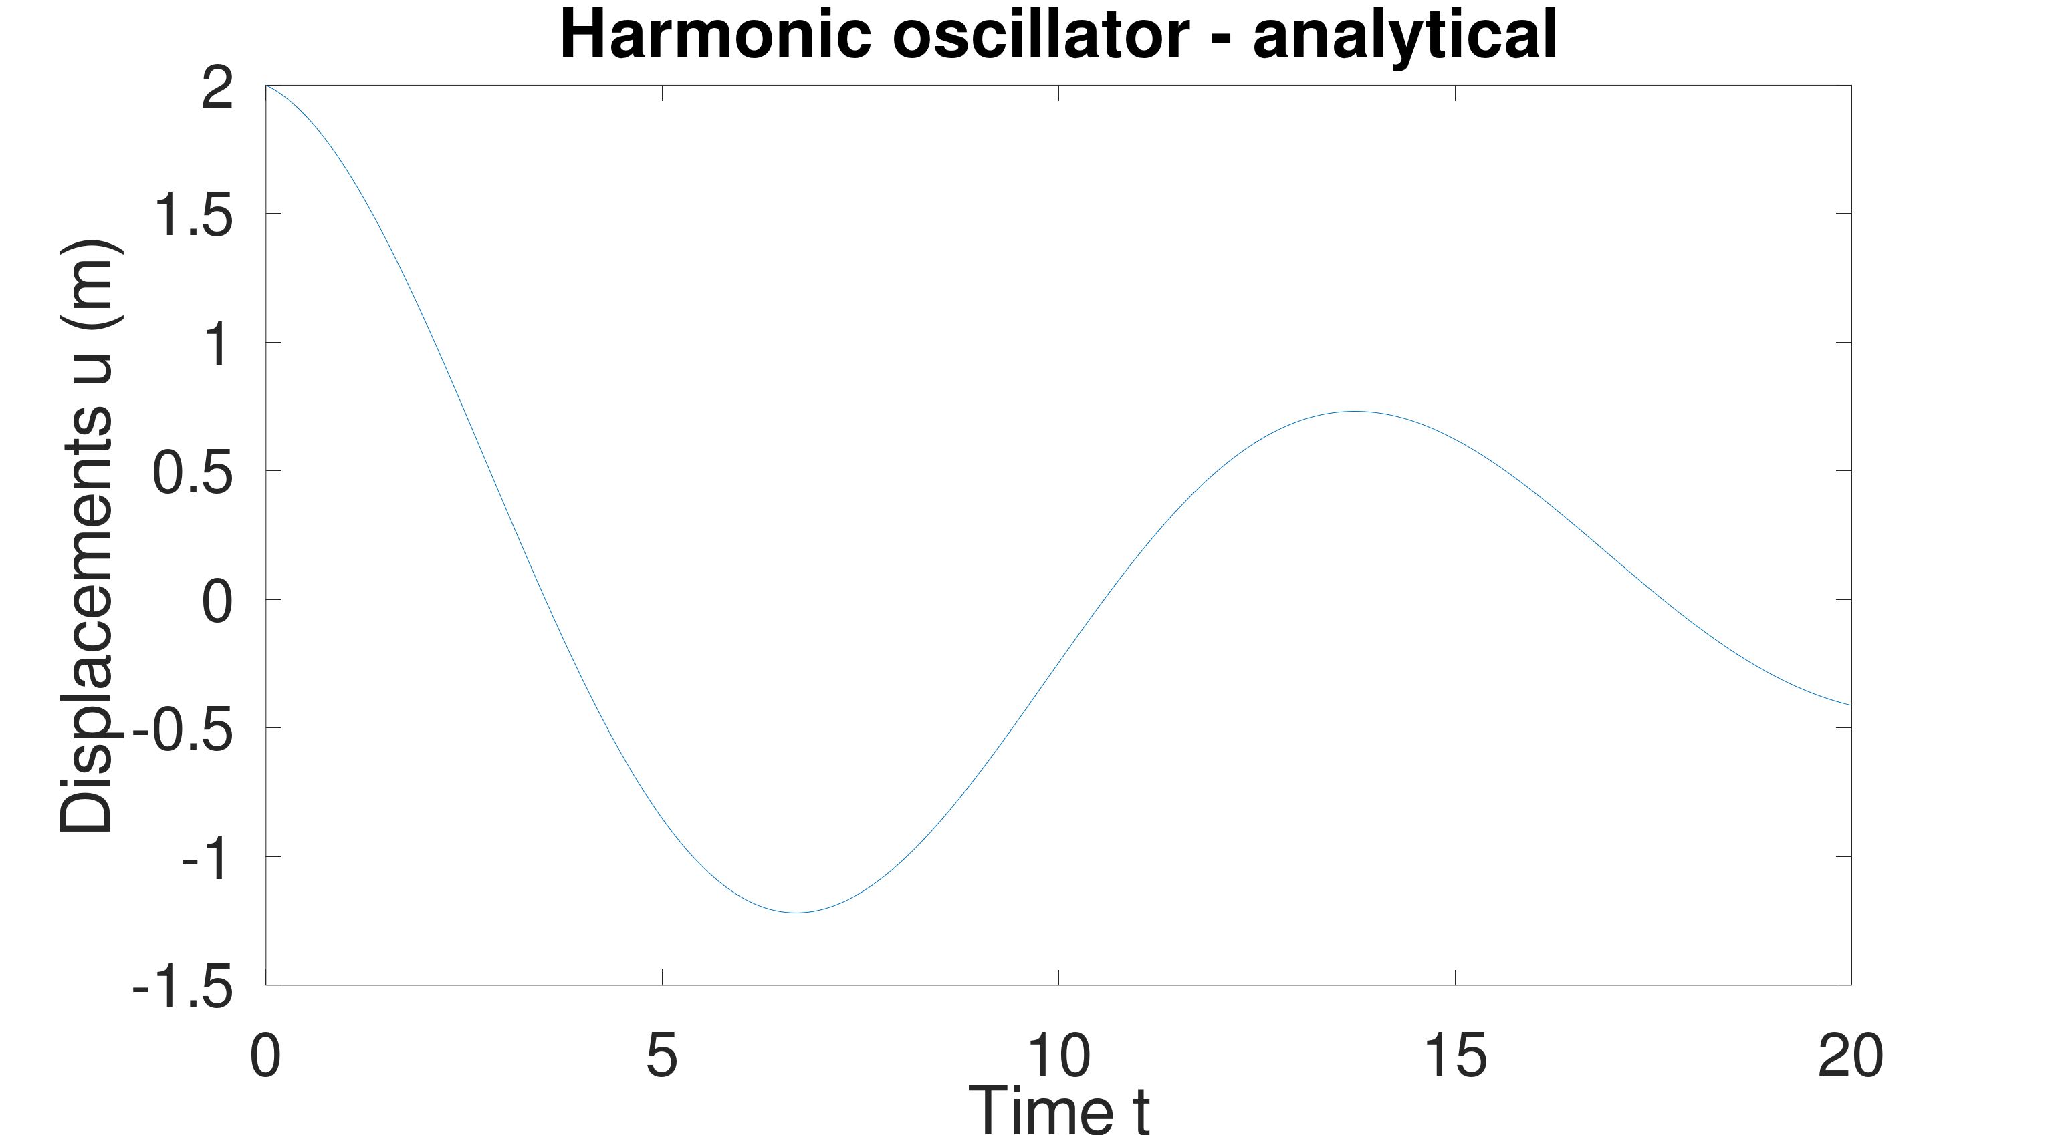

Slide 2
Myharmonic_Num([4 0.0001 4.5],[0:0.05:20],2,1)
Myharmonic_Num([4 1 4.5],[0:0.05:20],2,1)
Myharmonic_Num([4 0.65 4.5],[0:0.05:20],2,1)
Myharmonic_Num([4 10 4.5],[0:0.05:20],2,1)

Slide 4
Myharmonic_Num([4 0.65 1.5],[0:0.05:20],2,1)
Myharmonic_Num([4 0.65 100],[0:0.05:20],2,1)
Myharmonic_Num([4 0.65 4.5],[0:0.05:20],2,1)

Slide 7
load('u_meas0.mat');
y_0 = 10
y_0 = 5
y_0 = 1

Slide 8
x = 33.894 18.918 80.637, x0 = [60, 5, 20]
x = 26.0247 5.8983 25.1416 x0 = [30, 5, 20]

Slide 9
x =
39.042 19.684 83.906
x0 = [60, 10, 20]
x =
32.561 18.712 79.759
x0 = [60, 5, 10]

Slide 11
x = 39.042 19.684 83.906, x0 = [60, 5, 10]
x = 32.561 18.712 79.759 , x0 = [60, 10, 20]

